Slide 1

SOFTDEV
SHELL SCRIPT
Theo Fahey and Sadid Ethun

Slide 2
What is a Shell Script?
A shell script is a program to be run by a shell
A shell is a command line interpreter
Steve Bourne created the first shell for Unix

Slide 3
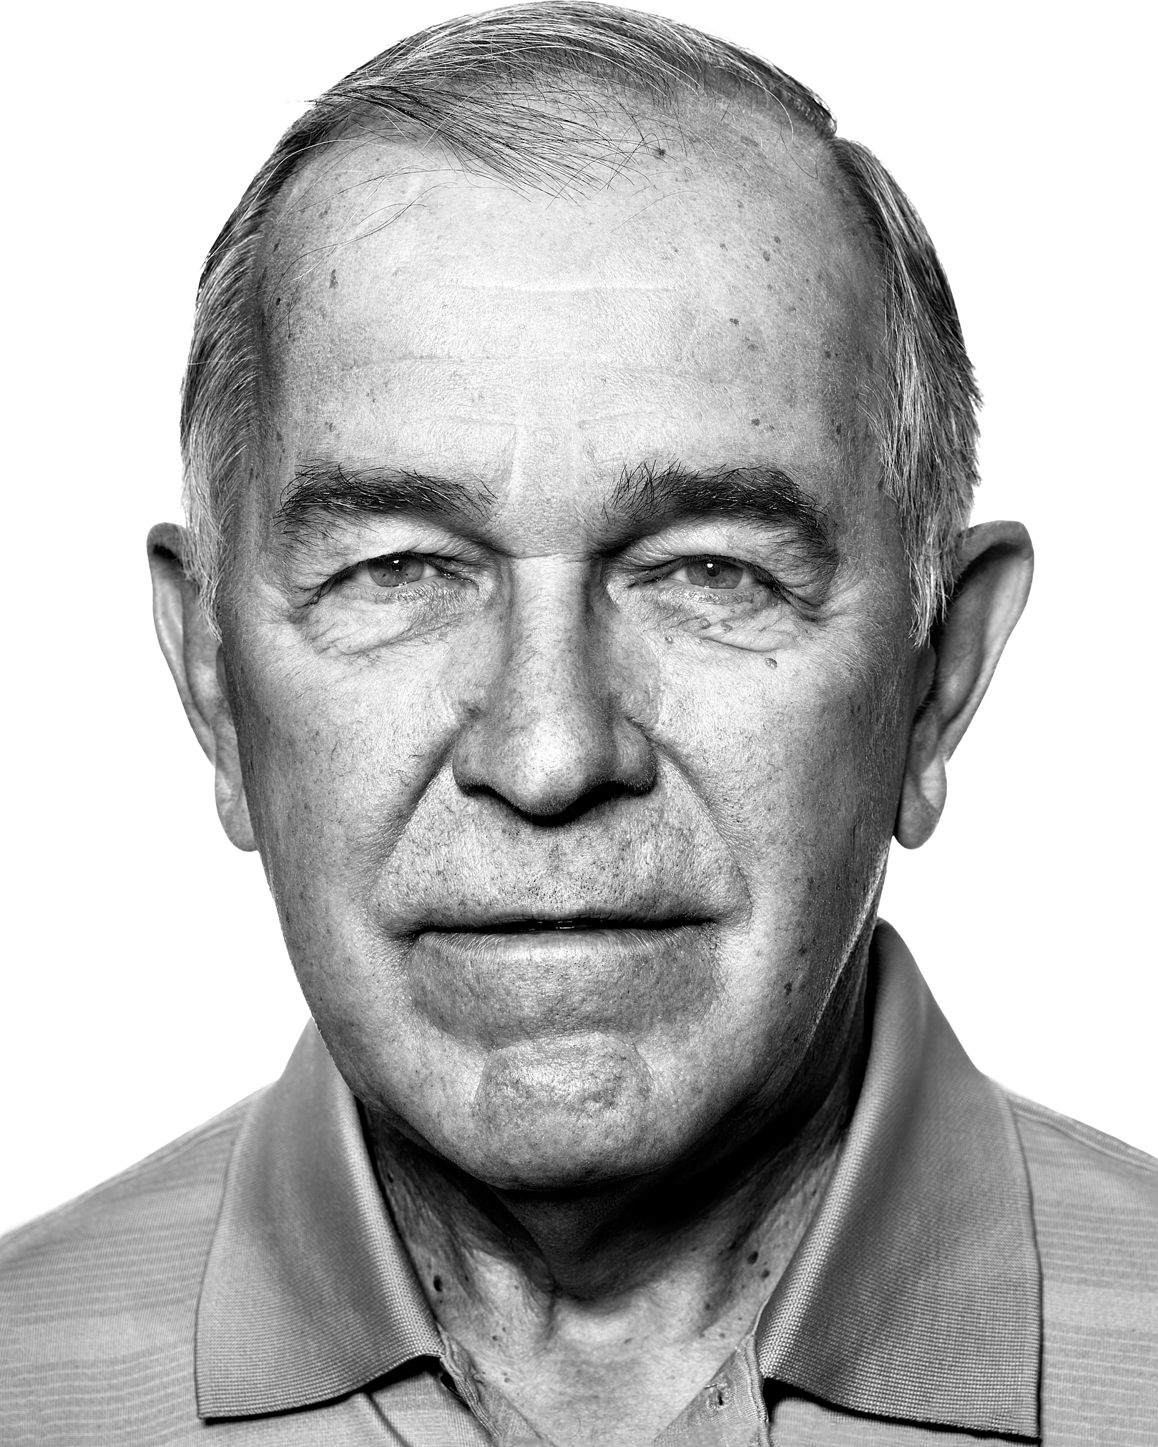
History of Unix Shells
First shell was made by Ken Thompson in 1971
Steve Bourne made the Bourne Shell in 1977
Goals to interactively execute commands and writing reusable scripts

Slide 4
Additions to Scripts
Control Flows ex. if, then, else statements
Loops ex. for, while, until
Variables ex. a=”hello”

Slide 5

Bash
Bourne-Again Shell made to replace the Bourne Shell
Improvements such as command history, command-line editing, and job control (pausing and resuming processes)

Slide 6
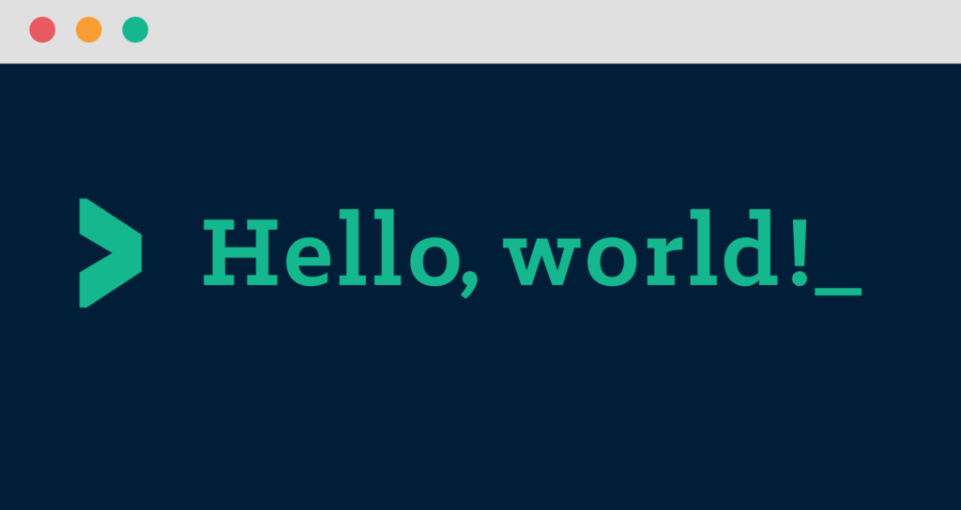
Hello World
#!/bin/bash
echo "Hello, world!"

Slide 7

Running
To run a .sh file, you must make the file executable using chmod +x
No need to compile separately as the language is written for the shell to understand

Slide 9



Slide 10
Mission
Hack into Dr. Doofenshmirtz’s computer
Place a bash script into his home directory
Automatically backup his secret folders onto Major Monograms server

Slide 11
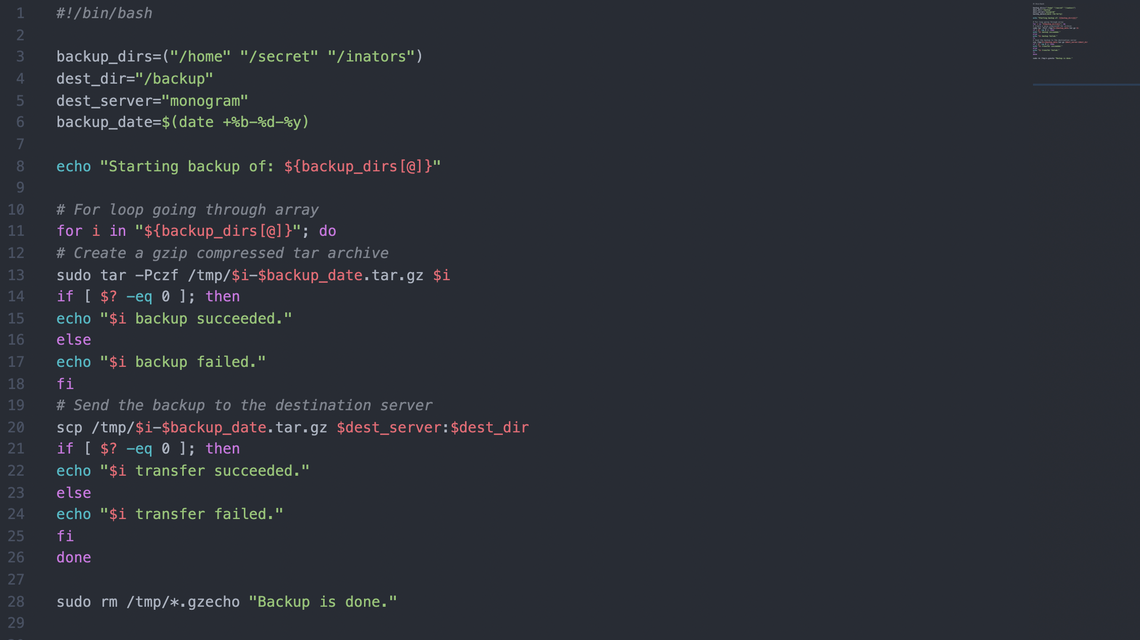

Slide 12
Variables
The shell treats the “=” sign as a variable assignment
There cannot be spaces around the “=” sign
The shell does not care about types of variables
Some special variables are already set

Slide 13
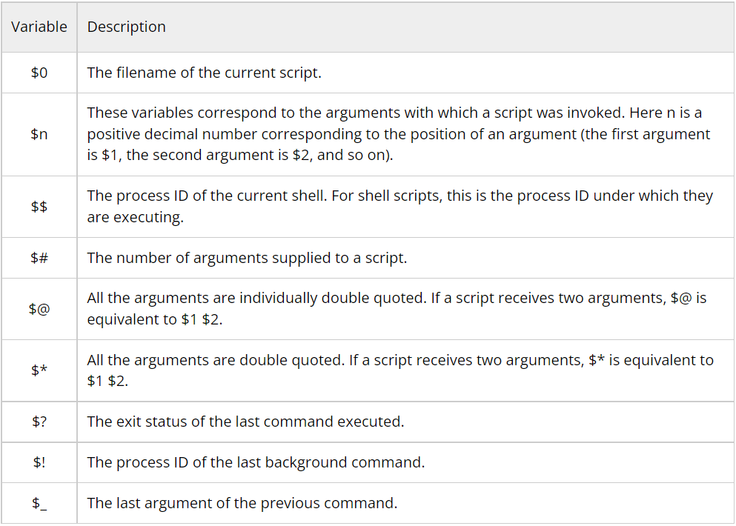
Variables
message="Hello World"
echo $message
echo "What is your name?"
read USER_NAME
echo "Hello $USER_NAME"

Slide 14
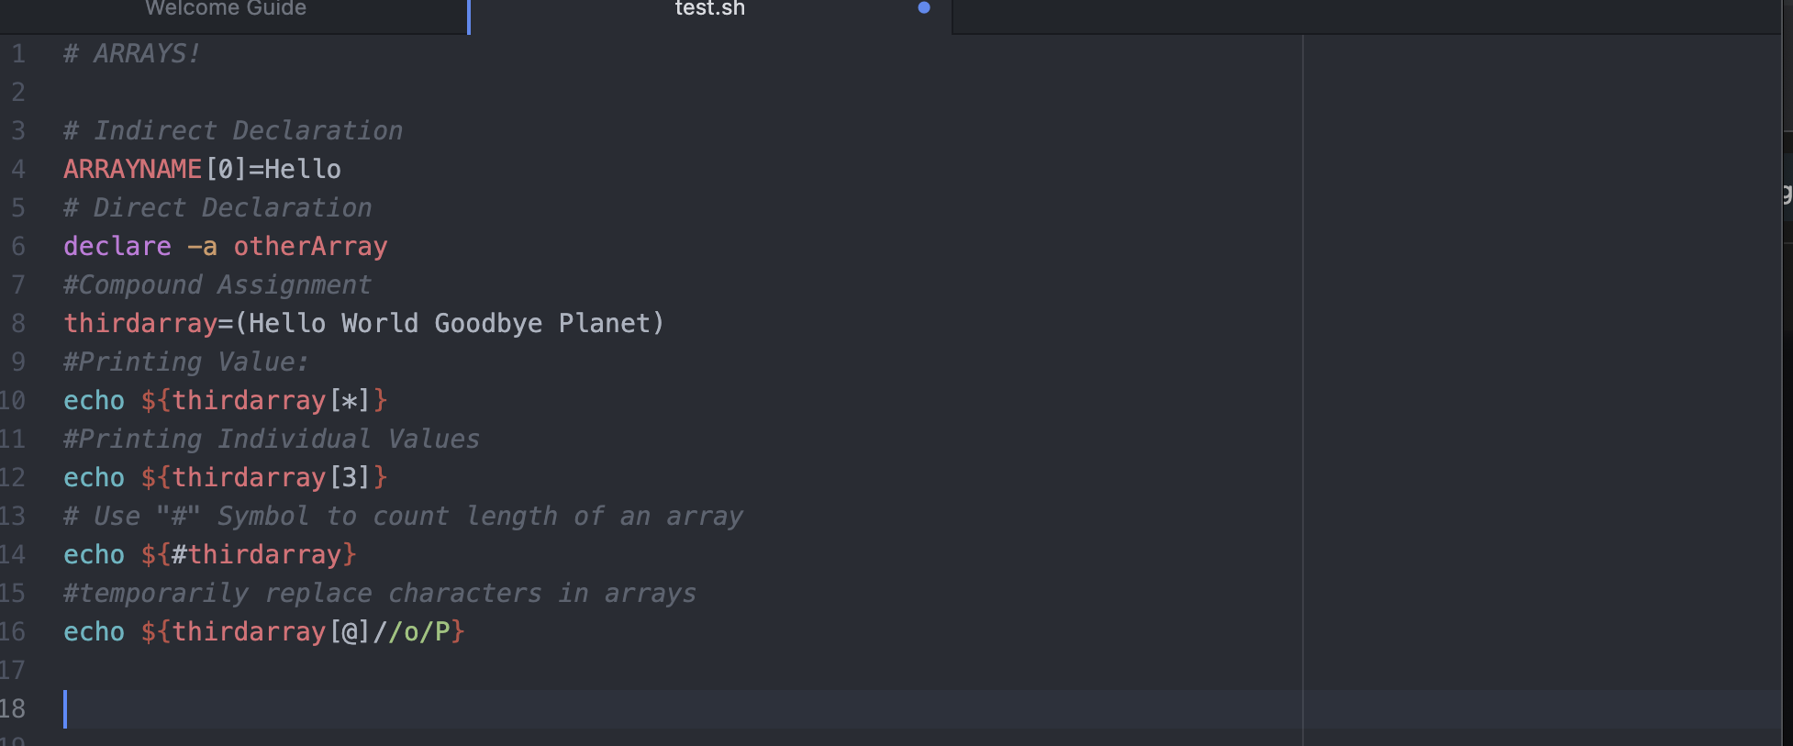
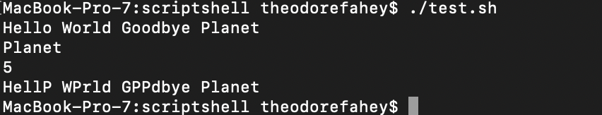
Arrays

Slide 15
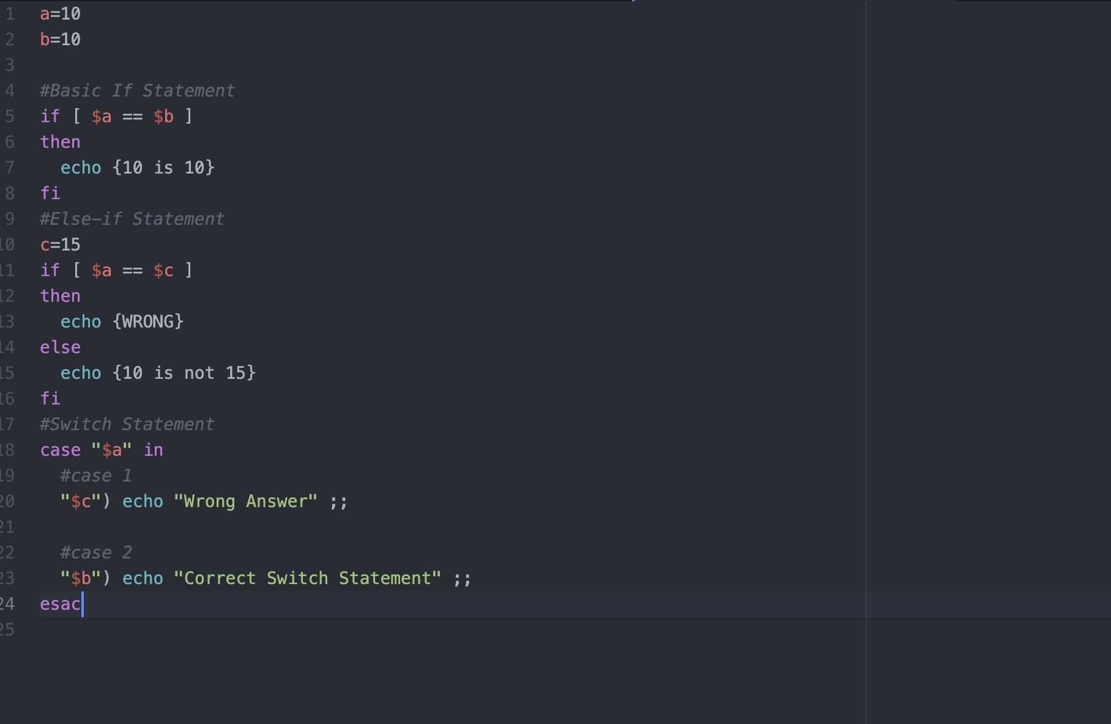
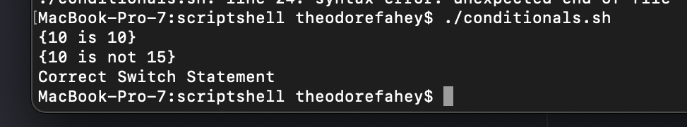
Conditionals

Slide 16
Loops
for loops iterate through a set of values until the list is exhausted
for i in 1 2 3 4 5
do
echo "Looping ... number $i"
done

Slide 17
Loops
while loops will run indefinitely until a specific case is reached
INPUT_STRING=hello
while [ "$INPUT_STRING" != "bye" ]
do
echo "Please type something in (bye to quit)"
read INPUT_STRING
echo "You typed: $INPUT_STRING"
done

Slide 18
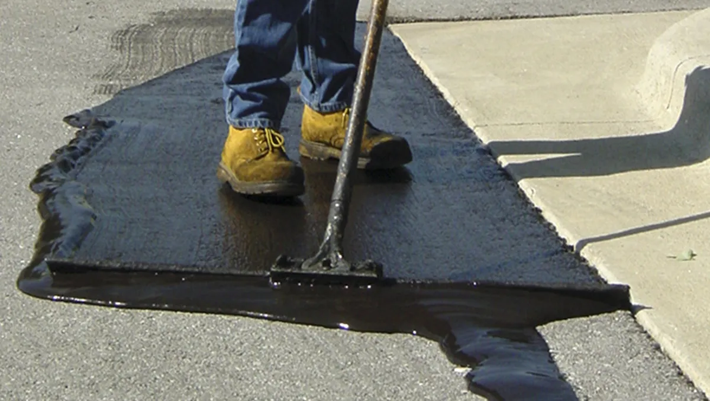
TAR
Perry uses the tar command which essentially creates a single file out of multiple files.
The -Pczf prefix which creates the the file and gives it a name.

Slide 19

Confusing Line
This line takes the previously created tar file and transfers it to the dest_dir inside of the dest_server.
Scp stands for "secure copy protocol" which is a means of securely transferring files between a local and remote host.

Slide 21


